Slide 1
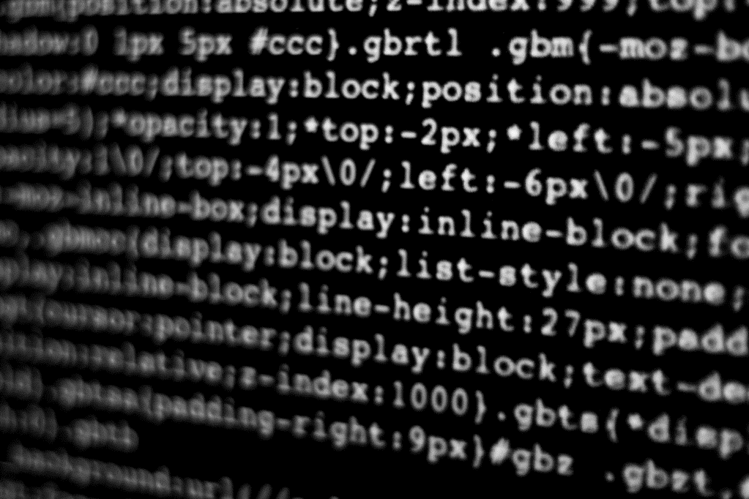
System Design & Analysis
PHASE two
2.7.2004

Slide 2
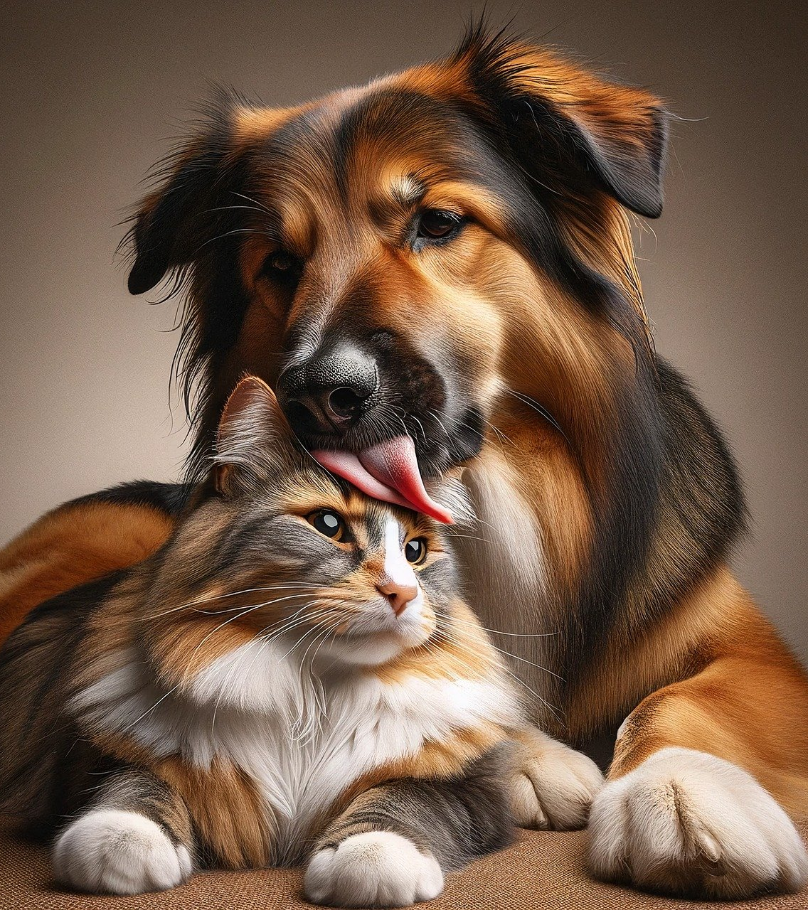
Catch phrase (in matt’s code)
PET NAMER
Would you like help picking a name for your pet?
Simply upload a picture and we’ll recommend a few different names for you!

Slide 3
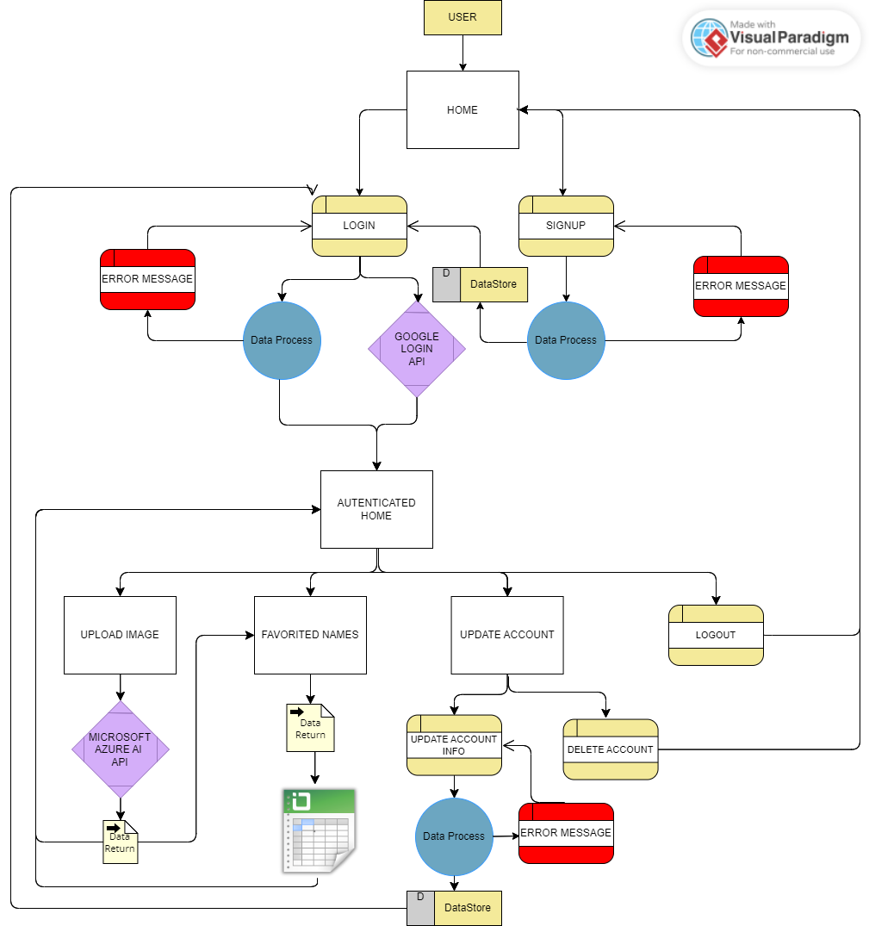
System Architecture and Data Flow Diagram
High level view at the different pages and data flows of our app.

Slide 4
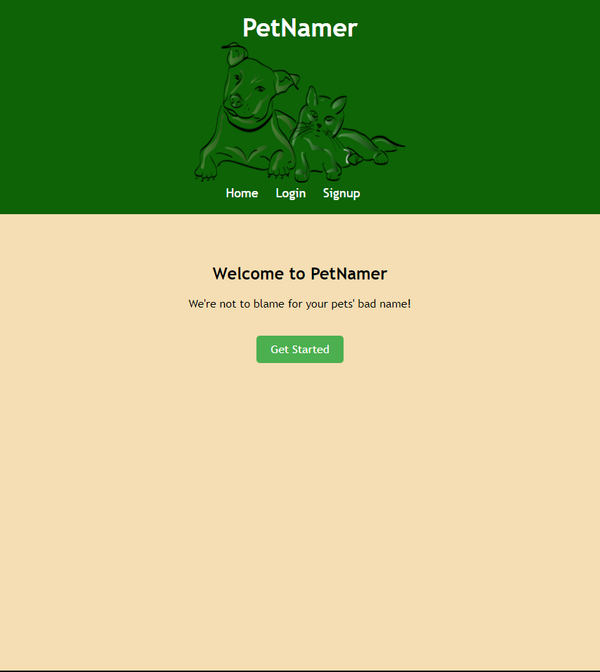
LANDING PAGE
The first page seen if the domain was www.petnamer.com
Greeted by adorable animals
Create an account in order to be able to save name suggestions

Slide 5
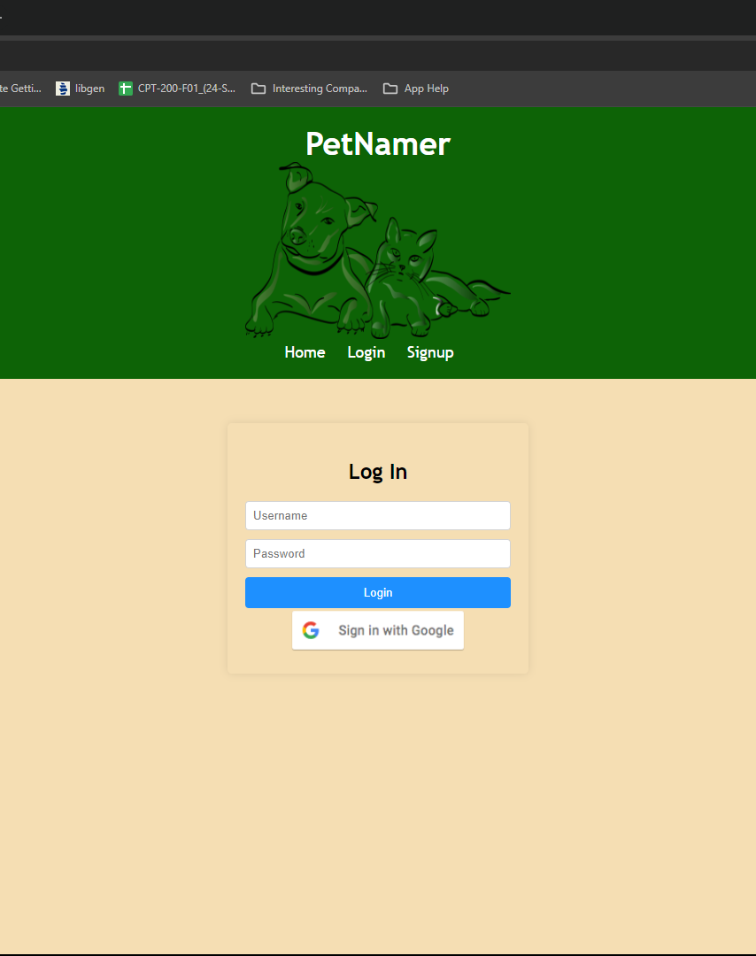
Login Page
In order to receive pet name suggestions a user will need to login to their account
In order to save names, user must be logged in
Use either Google Account or create account credentials

Slide 6
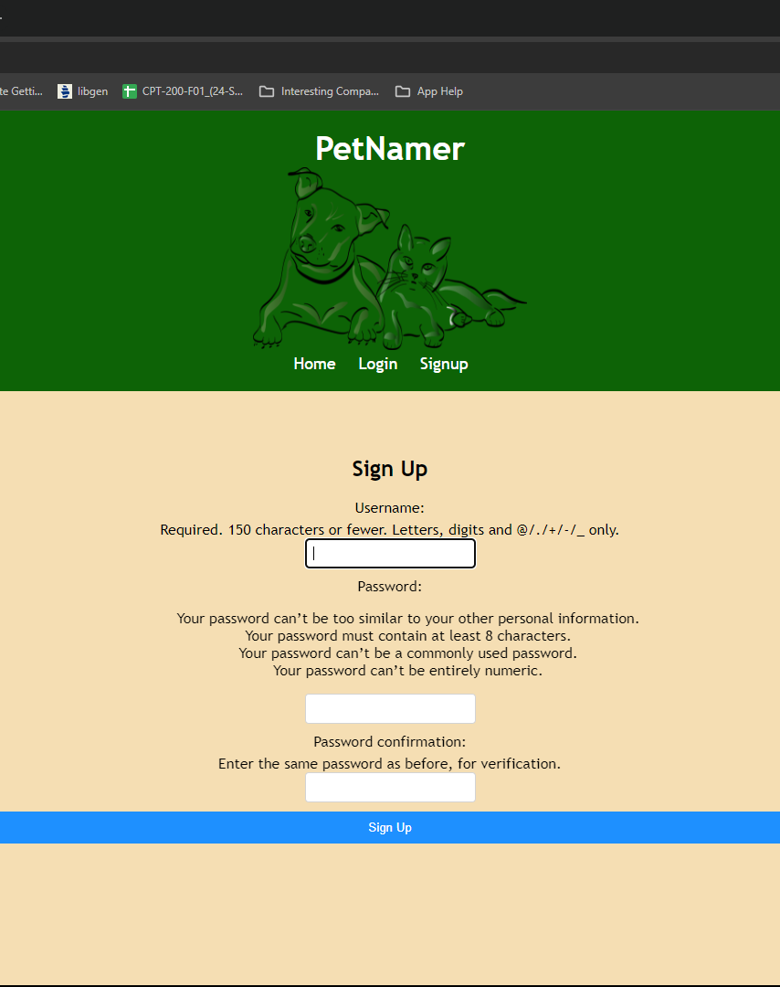
Signup Page
Uses Django Authentication Form
Checks if username is in user, if password is valid, if passwords match
Redirects to login page upon successful creation

Slide 7
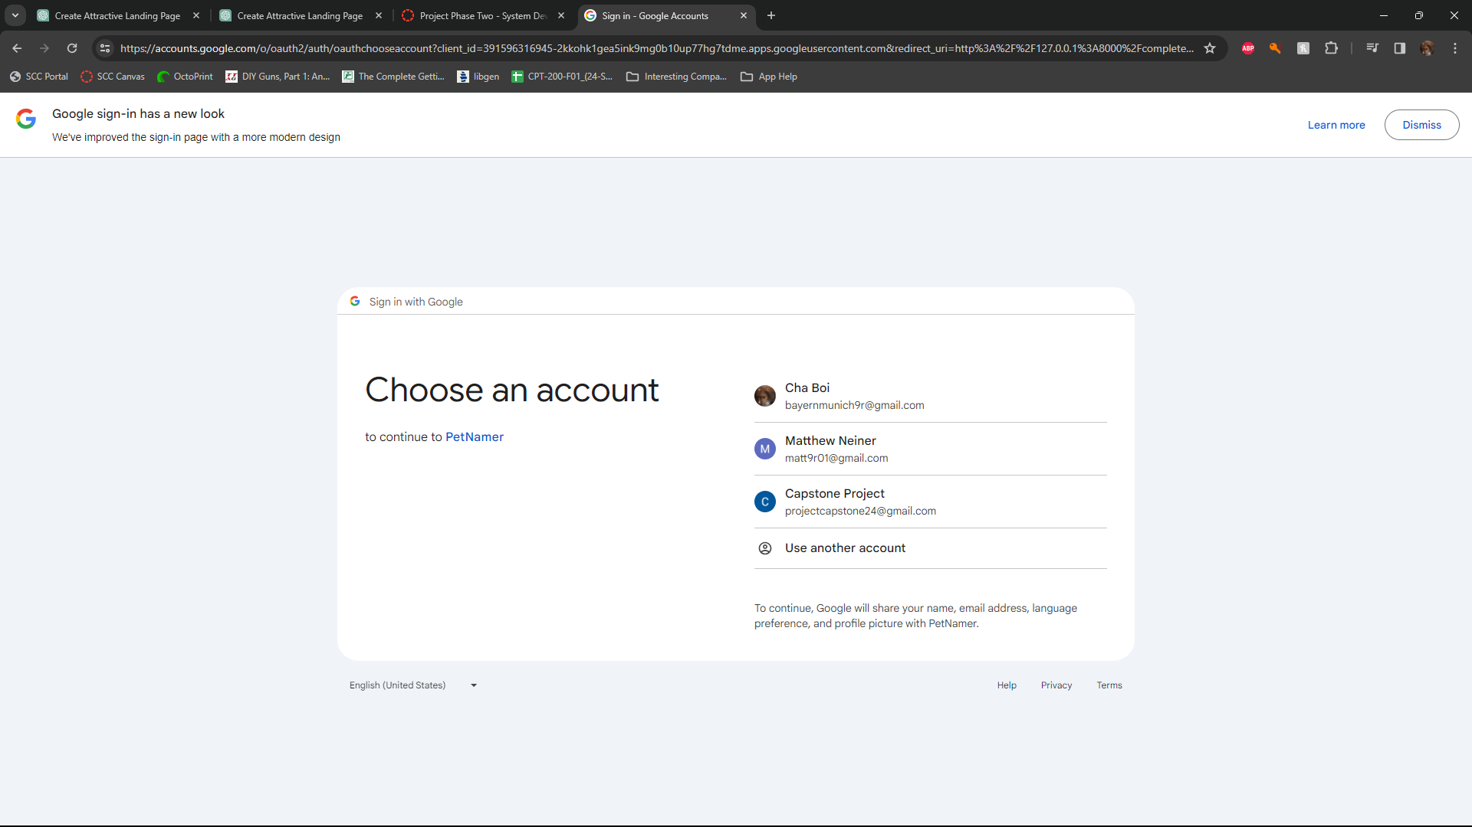
Google Login
Choose Google account to link to PetNamer app
Will use email and name to create account

Slide 8
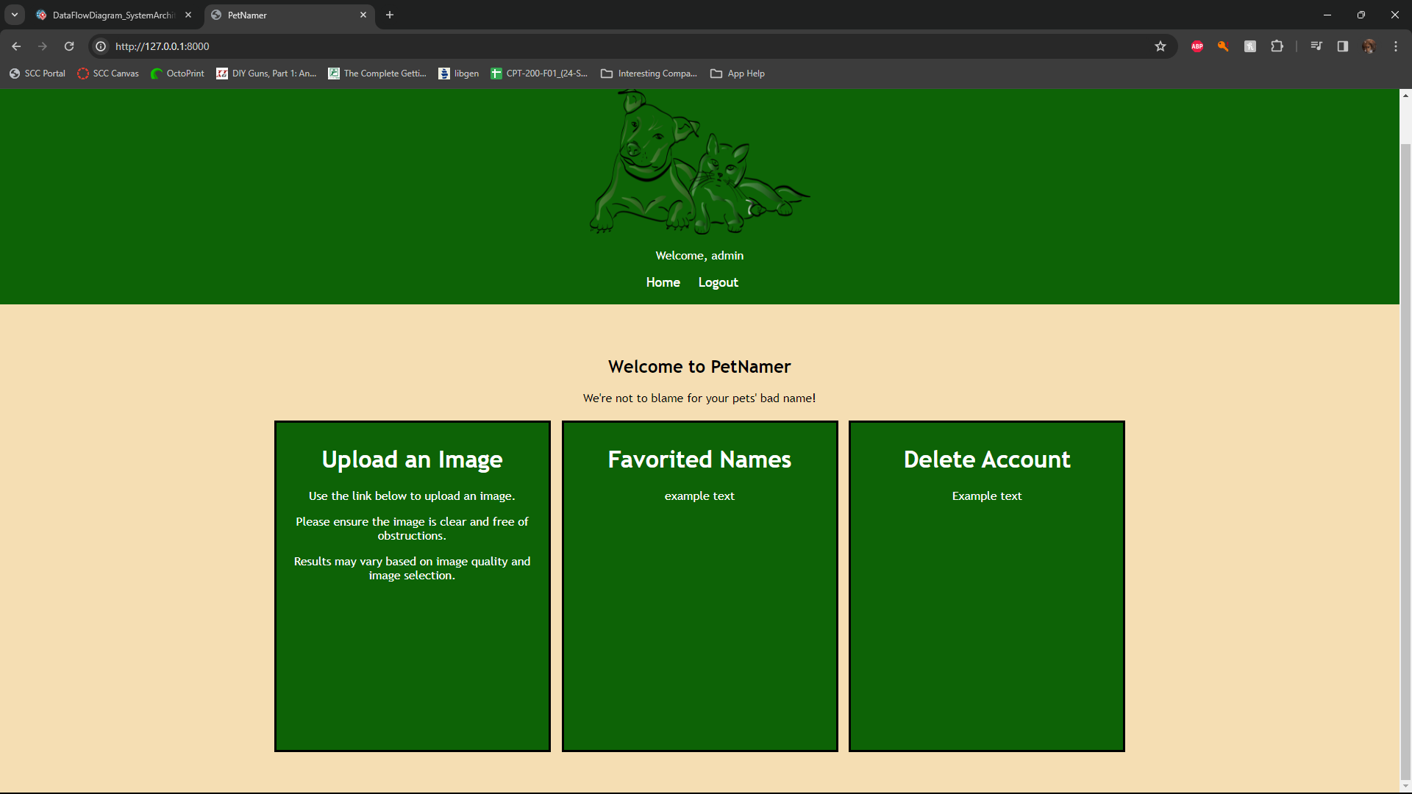
Authenticated Home
Different links for the different functions users can do
Upload a picture to be recognized
View names that the user has saved as favorites
Delete and Update Account

Slide 9
x
Landing page with account creation
Picture upload screen
Picture recognition response
Name suggestions from designated databases based on the animal and obvious features
Ability to save favorite names to account database

Slide 10

Technology
VSCode IDE
Python 3.11.8
Django
SQLite
Dbeaver (for viewing database tables)

Slide 11
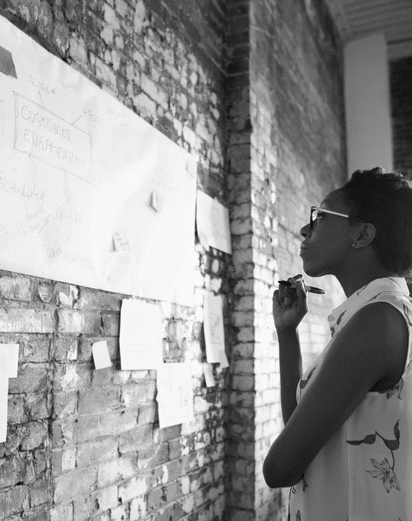
x
CURRENTLY RESEARCHING
We need an API for animal photo recognition, here’s what we are looking at possibly implementing:
Google Login API
Use Google Account to login to website
Microsoft Azure AI API
Uses Microsoft Azure AI to recognize image and return tag

Slide 12

x
After a client uploads a picture of their pet, our image recognition will be able to determine what kind of animal it is, then recommend names based off this information and a couple of other factors such as the animal’s coloring.

Slide 13
Implemented Queries
Django’s authentication library
Retrieves user from database
Verifies password is correct
Return user from database
Google Authentication Queries
Start by Django sending request to Google server
Google generates authentication token, which is validated by Django
Once verified, Django sends request for user information

Slide 14
Future Queries
Django provides Object-Relational-Mapping system
Use CRUD operations to interact with database
Retrieving animal names, filtering names based on attributes, creating a list of favorited names

Slide 15
Timeline & milestones
Phase 1 | Phase 2 | Phase 3 | Phase 4
February 7 | March 6 | April 10 | May 1
PROJECT SELECTED | FRONTEND DEVELOPMENT | BACKEND DEVELOPMENT | TESTING & ADJUSTMENT

Slide 16
THANK YOU
Team 1: Phase Two

